Slide 1
What Is Cloud Computing
Renting computing power over the internet instead of owning hardware
No need to buy or maintain servers
You only pay for what you use
Easy to scale up when busy and scale down when quiet

Slide 2
Key Cloud Features
Elastic: resources grow or shrink automatically
Self‑service: You can create servers or services in minutes
Global: data centres around the world
Managed: the cloud provider handles hardware, networking, and updates
High Availability
Fault Tolerance
Disaster Recovery
Agility

Slide 3
Why Developers Use the Cloud
Build and release apps fast
No upfront cost for equipment
Easy to try ideas and experiment
Tools for deployment, monitoring, and automation already included
High reliability without needing specialist hardware knowledge

Slide 4
How Cloud Costs Work
Pay‑as‑you‑go: like an electricity bill
Reserved options: cheaper if you commit long‑term
Serverless: pay only when your code runs
Turn things off when not needed to save money

Slide 5
Servers on Demand
Create a server in minutes
Choose CPU, RAM, storage, and region
Scale up for busy periods, scale down when quiet
Great for dev, test, and production environments

Slide 6
Load Balancing
Shares traffic across multiple servers
Prevents a server from overloading
Helps apps stay fast and reliable
Automatically sends traffic to other healthy servers if one fails

Slide 7
Monitoring & Observability
Track CPU, memory, network, and errors
View logs to understand what happened
Set alerts when something goes wrong
Helps keep apps stable and secure

Slide 8

Deployment Services
Compute (virtual machines)
AWS EC2, Azure Virtual Machines, Google Compute Engine
Containers
AWS ECS/EKS, Azure AKS, Google GKE
Serverless
AWS Lambda, Azure Functions, Google Cloud Functions
App Hosting
Azure App Service
AWS Elastic Beanstalk
Google App Engine

Slide 9
Availability
Cloud providers run multiple data centres
Automatic failover if something breaks
SLAs often 99.9% or higher
Multi‑region setups for global reliability

Slide 10

Security in the Cloud
Shared responsibility:
Provider secures the infrastructure
You secure your code, data, and access
Encryption for data in transit and at rest
Identity and Access Management (IAM)
Firewalls, private networks, and monitoring tools

Slide 11
Responsibility
On-Premises
IaaS (infrastructure)
PaaS (platform)
SaaS (software)
Application
Application
Application
Application
Data
Data
Data
Data
Runtime
Runtime
Runtime
Runtime
Middleware
Middleware
Middleware
Middleware
Operating System
Operating System
Operating System
Operating System
Virtualisation
Virtualisation
Virtualisation
Virtualisation
Physical server
Physical server
Physical server
Physical server
Physical storage
Physical storage
Physical storage
Physical storage
Physical network
Physical network
Physical network
Physical network
Managed by customer
Managed by vendor

Slide 12
Summary
Cloud = flexible, scalable, cost‑efficient computing
Makes development faster and easier
Includes tools for deployment, monitoring, and scaling
Strong availability and security features
Ideal for modern software development teams

Slide 13
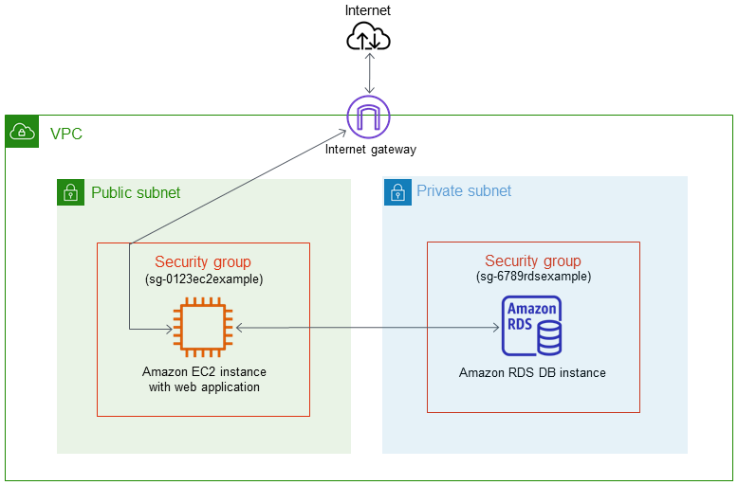
Lab activity - RDS and DynamoDB
Upon completion of this Lab, you will be able to:
Create RDS or DynamoDB databases
Use the AWS Console to create subnet groups
Manage access by using security group rules
Connect to and use the databases you create
RDBMS - RDS
Please take an hour to perform one of these labs
NoSQL - DynamoDB
Notes:
https://app.qa.com/lab/create-your-first-amazon-rds-database/ (approx. 1hr 15min)
https://app.qa.com/lab/introduction-dynamodb/ (approx. 1hr)

